Slide 1
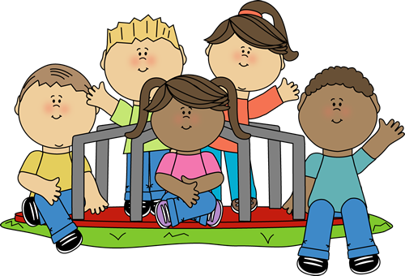
Asking Someone to play!

Slide 2
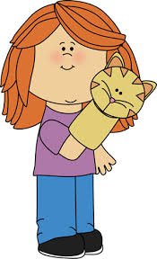
I Love To Play!
I love to play games!
But sometimes I like to play with other kids

Slide 3
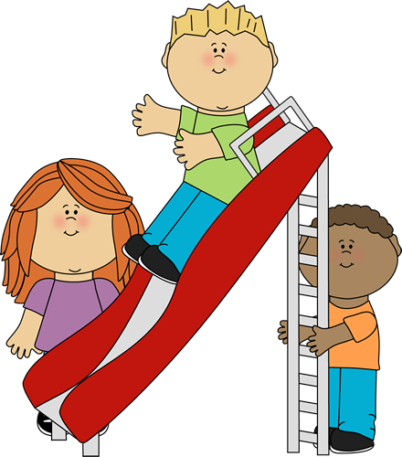
At Recess
At recess, there are lots of other kids to play with

Slide 4
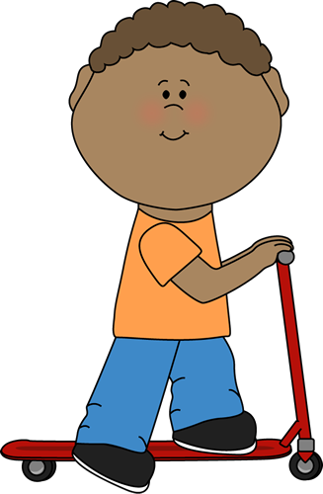
Joey
Today, I want to ask Joey to play with me

Slide 5
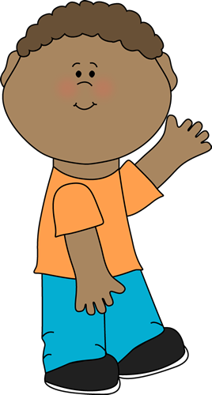
What should I do?
First, I go up to Joey and say “Hi Joey!”
Hi Joey!

Slide 7
Now what?
Then I ask, “Can I play with you?” or “Do you want to play with me?”
Can I play with you?

Slide 8
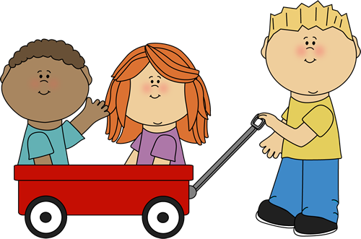
Yes!
If the person says yes, then I get to play with them!

Slide 9
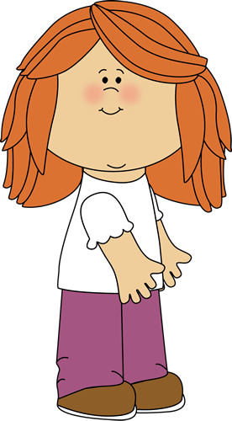
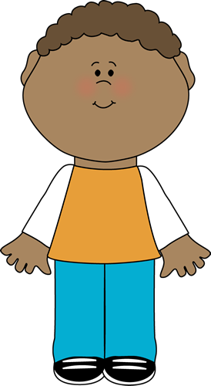
No thanks!
If the person says no, I can find someone else to play with, it is ok!
I am playing with Nick today
It is ok!

Slide 10
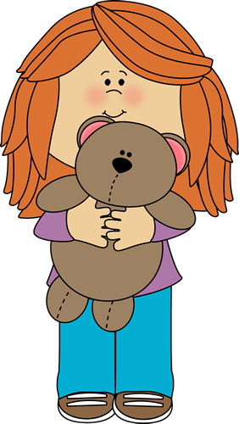
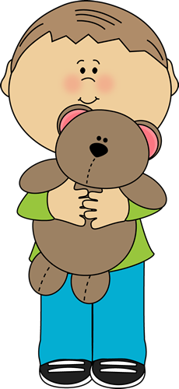
It’s Ok!
I will not feel sad about this, I will go find someone else to play with!

Slide 11
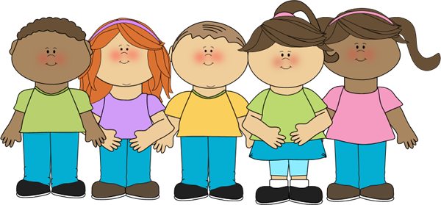
Time to play!
It makes me feel happy that I know how to ask someone to play with me!

Slide 13
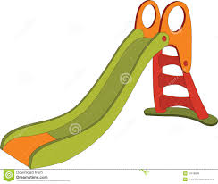

Slide 14
